Slide 1
What should be name our shiny app?

Slide 2
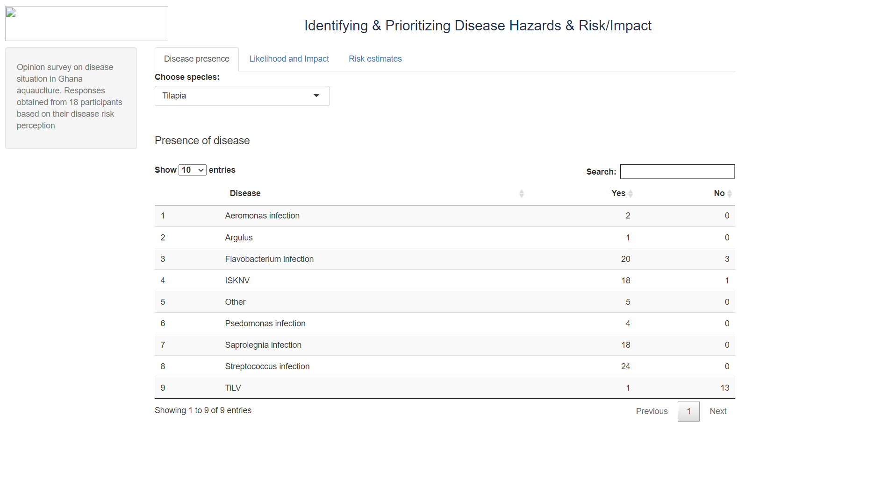
NVI logo
Heading is “Biosecurity scoring system”
Add more tabpanel
Add a dropbox for choose question:

Slide 3

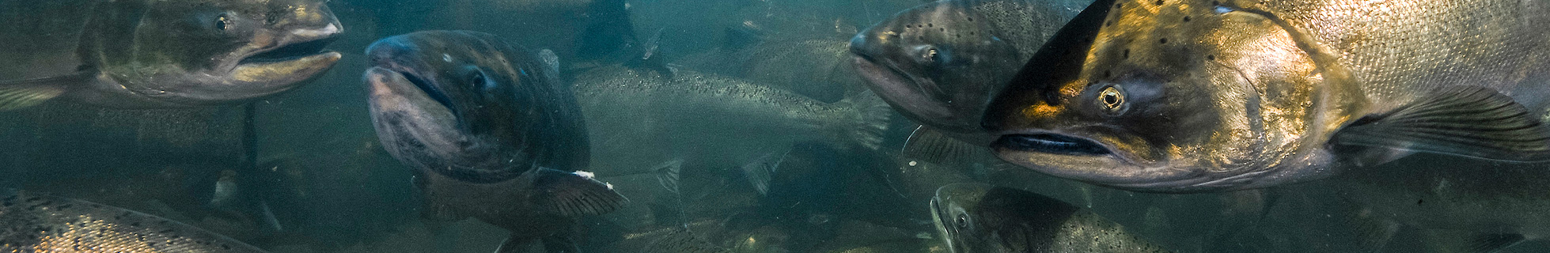





Biosecurity scoring system
WELCOME!
Biosecurity is key to prevent the introduction, development and spread of transmissible animal diseases to, from and within an animal population.
Home
What is Biosecurity
The aim of our study was to obtain an overview of farm and health management, biosecurity measures, fish health monitoring and disease diagnostics of Norwegian Atlantic Salmon farms.
Summary statistics
This app will allow you to visualize what biosecurity measures farmers apply on their facility and what factors are potentially associated with high mortality.
Risk factors
You will also be able to evaluate your farm biosecurity level with a biosecurity scoring system developed for Atlantic Salmon farms, on the basis of farm management and biosecurity practices
Biosecurity evaluation
Collaborators
Project description:
Funding agency:
Links to relevant websites:
Contact Person:

Slide 4
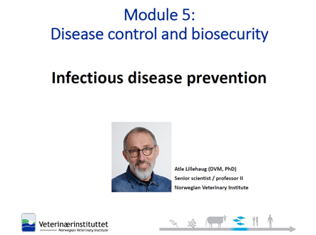
Biosecurity scoring system
What is biosecurity:
Importance of biosecurity:
Home
Video
What is Biosecurity
Summary statistics
Risk factors
Biosecurity evaluation
Biosecurity evaluation
External biosecurity
Internal biosecurity

Slide 5
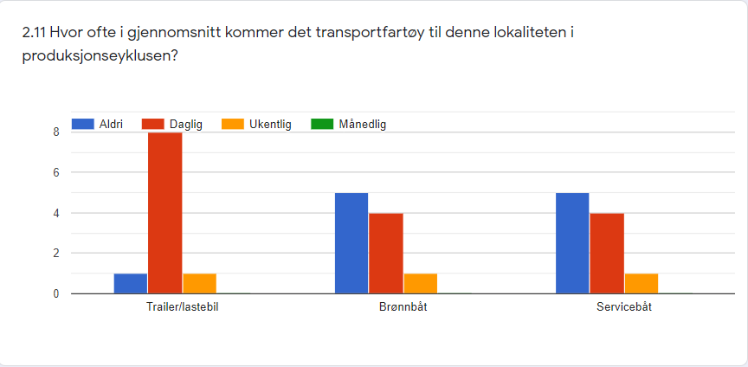

We need to create 2 rows:
One with the category one one with the identifier
Biosecurity scoring system
In this section you can select a category from the survey and the questions that comprise it to get a summary of the responses
Select type of production
Select a category
Select a question
Production of eggs
9.Utstyr & kjøretøy
9.4.Hvis utstyr blir benyttet ma
Home
What is Biosecurity
Summary statistics
Filter by question 2.6
Risk factors
Biosecurity evaluation

Slide 6
Biosecurity scoring system
This table shows the 30 variables found to have a statistically significant association with the occurrence of high mortality.
Home
What is Biosecurity
Summary statistics
Risk factors
Biosecurity evaluation

Slide 7
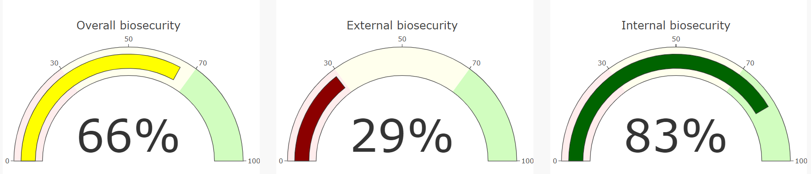
Biosecurity scoring system
2 tabs
Statistic for Norway
My scoring
Here you can find the biosecurity averages based on all surveys. These statistics are divided by production type.
2 options/2 r scripts :
Production of eggs, fry and post smolt (Hatchery)
Production of adult fish (On-growing)
Filter by question 2.6
Select type of production
Home
On-growing
What is Biosecurity
Statistics for on-growing production (Average Norway)
Summary statistics
Risk factors
Biosecurity evaluation
Continue

Slide 8
Biosecurity scoring system
2 tabs
Statistic for Norway
My scoring
 | Average for Norway
External Biosecurity
1) Location of the farm | 66.67%
2) Introduction of live fish | 70.00%
3) Feed supply | 90.00%
4) Biovectors | 90.00%
5) Personnel and visitors | 89.47%
6) Use of divers | 68.00%
7) Equipment and vehicles | 64.51%
Subtotal external Biosecurity | 77%
Internal biosecurity
8) Vaccination | 69.09%
9) Disease management | 83.10%
10) Rearing management | 90.00%
11) Feed management | 95.20%%
12) Waste management | 100%
13) Harvesting | 84.00%
14) Equipment, Cleaning and Disinfection | 74.17%
15) Biosecurity program and record keeping | 91.11%
Subtotal internal Biosecurity | 84%
Overall biosecurity | 81%
Number of surveys completed: 46
Home
What is Biosecurity
Summary statistics
Risk factors
Biosecurity evaluation

Slide 9
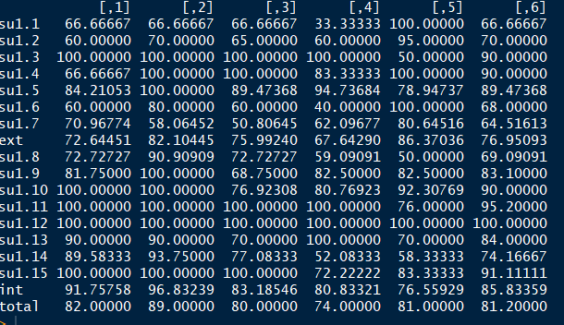
benchmarking<-cbind(myscore,meanscore)
Norway average
Farm 1
Farm 2
Farm 3
Farm 4
Farm 5

Slide 10
Biosecurity scoring system
Statistic for Norway
My scoring
We have to associate each questionnaire with an email and a password (they can only see their score and the average)
Login
Email:
Password:
Home
What is Biosecurity
Summary statistics
margaridagl@hotmail.com
Risk factors
Biosecurity evaluation
***********
Continue

Slide 11
Biosecurity scoring system
 | My scoring | Average for Norway
External Biosecurity
1) Location of the farm | 66,67% | 66.67%
2) Introduction of live fish | 66.00% | 70.00%
3) Feed supply | 100% | 90.00%
4) Biovectors | 66.66% | 90.00%
5) Personnel and visitors | 84.21% | 89.47%
6) Use of divers | 60.00% | 68.00%
7) Equipment and vehicles | 70.97% | 64.51%
Subtotal external Biosecurity | 73% | 77%
Internal biosecurity
8) Vaccination | 72.73% | 69.09%
9) Disease management | 81.75% | 83.10%
10) Rearing management | 100% | 90.00%
11) Feed management | 100% | 95.20%%
12) Waste management | 100% | 100%
13) Harvesting | 90.00% | 84.00%
14) Equipment, Cleaning and Disinfection | 89.58% | 74.17%
15) Biosecurity program and record keeping | 100% | 91.11%
Subtotal internal Biosecurity | 92% | 85,8%
Overall biosecurity | 82% | 81%
Number of surveys completed: 46
PDF
Home
What is Biosecurity
Summary statistics
Download into pdf file
Risk factors
Biosecurity evaluation
Continue

Slide 12
benchmarking<-cbind(myscore,meanscore)
Norway average
Farm 1
Farm 2
Farm 3
Farm 4
Farm 5

Slide 13
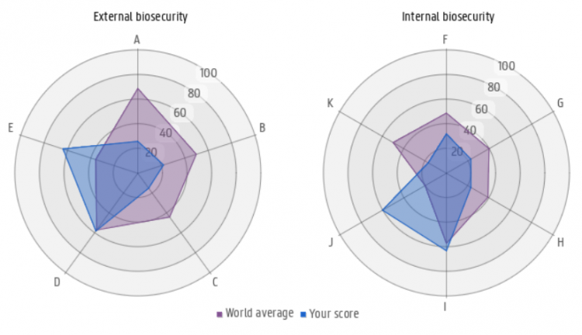
Biosecurity scoring system
Benchmarking
Home
What is Biosecurity
Summary statistics
Risk factors
Biosecurity evaluation
My score
Average for Norway
Continue

Slide 14
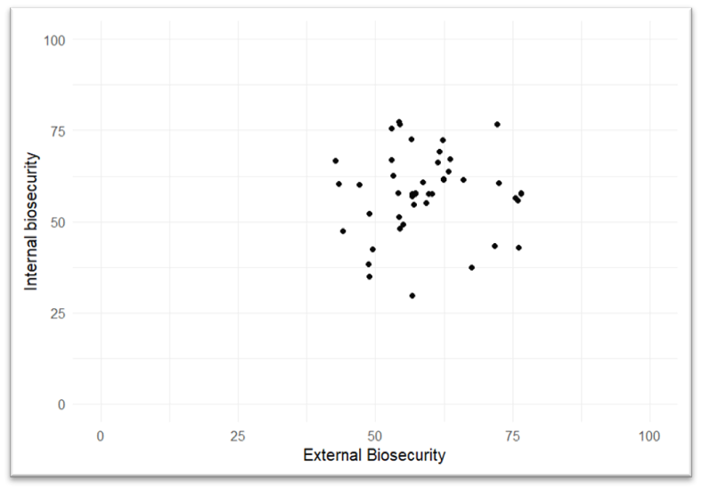
Biosecurity scoring system
Benchmarking
My score
Home
What is Biosecurity
Summary statistics
Risk factors
Biosecurity evaluation
Continue

Slide 15
Biosecurity scoring system
Select a subcategory
1) Location of the farm
Question | Answer | Score
Hvor er lokaliteten plassert? | I åpen sjø, innaskjærs (fjord) | 0/4
Hvor mange aktive lokaliteter med laksefiskprosduksjon finnes innenfor en radius på 10 km fra denne lokaliteten? [Settefiskanlegg] | Ingen | 5/5
Hvor mange aktive lokaliteter med laksefiskprosduksjon finnes innenfor en radius på 10 km fra denne lokaliteten? [Postsmolt] | Ingen | 7/7
Hvor mange aktive lokaliteter med laksefiskprosduksjon finnes innenfor en radius på 10 km fra denne lokaliteten? [Matfisk] | 1-5 lokaliteter | 8/8
Hvor mange aktive lokaliteter med laksefiskprosduksjon finnes innenfor en radius på 10 km fra denne lokaliteten? [Slakteri og/eller videreforedlingsbedrift] | 1-5 lokaliteter | 0/8
Finnes det gjerder, porter eller skilt som advarer personer og kjøretøy mot adgang til anlegget uten tillatelse? | Ikke aktuelt, da lokaliteten ikke er på land | 3/3
Subcategory score |  | 23/27 (23*100)/27=85,2%
Home
What is Biosecurity
Summary statistics
Risk factors
Biosecurity evaluation

Slide 16
Biosecurity scoring system
Select a subcategory
1) Location of the farm
Location of the farm
Hvor mange aktive lokaliteter med laksefiskprosduksjon finnes innenfor en radius på 10 km fra denne lokaliteten? [Matfisk]
Hvor mange aktive lokaliteter med laksefiskprosduksjon finnes innenfor en radius på 10 km fra denne lokaliteten? [Slakteri og/eller videreforedlingsbedrift]
Finnes det gjerder, porter eller skilt som advarer personer og kjøretøy mot adgang til anlegget uten tillatelse?
Hvor mange aktive lokaliteter med laksefiskprosduksjon finnes innenfor en radius på 10 km fra denne lokaliteten? [Postsmolt]
Hvor mange aktive lokaliteter med laksefiskprosduksjon finnes innenfor en radius på 10 km fra denne lokaliteten? [Settefiskanlegg]
Hvor er lokaliteten plassert?
0
1
1
0,5
0
1
Home
What is Biosecurity
Summary statistics
Risk factors
Biosecurity evaluation

Slide 17
Biosecurity scoring system
Select a subcategory
1) Location of the farm
Home
What is Biosecurity
Summary statistics
Risk factors
Biosecurity evaluation

Slide 18
Biosecurity scoring system
Select a subcategory
We could also use a lollipop graphic
1) Location of the farm
Home
What is Biosecurity
Summary statistics
Risk factors
Biosecurity evaluation

Slide 19
Biosecurity scoring system
Select a subcategory
1) Location of the farm
Home
What is Biosecurity
Summary statistics
Risk factors
Biosecurity evaluation

Slide 20
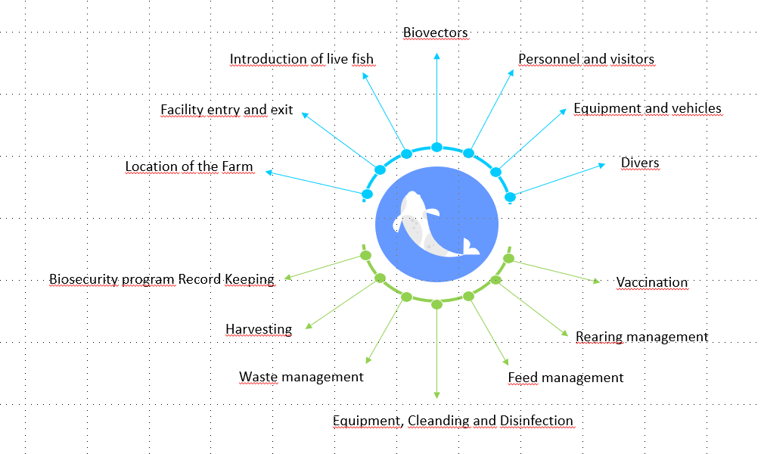
Explanation (Not for the app)
2 Categories
External biosecurity
Internal biosecurity
Hatchery:
Internal Biosecurity- 7 subcategories
External Biosecurity- 7 subcategories
On-growing:
Internal Biosecurity- 7 subcategories
External Biosecurity- 8 subcategories

Slide 21

Materials and methods
Example
Subcategory: Facility entry and exit
Hatcheries: experts attributed a weight of 6.7
Question | Weight of the question | Answer possibilities
 |  | Best | Score | Worst | Score
Do you keep the gate locked when not in use? | 5 | -Yes | 1 | -No -Don’t know | 0
Are there fences, gates and or signs on the facility which prevent people and vehicles from entering without permission? | 5 | -Yes | 1 | -No -Don’t know | 0
Do you control and monitor visitors and vehicles entering and exiting the facility? | 6 | -Yes | 1 | -No -Don’t know | 0
Are there footbaths at all entrances to the facility? | 9 | -Yes | 1 | -No -Don’t know | 0
Are vehicles disinfected on entry to the facility? | 9 | -Yes | 1 | -No -Don’t know | 0
5 questions
1- full presence of biosecurity measure/ total absence of risk
0- total absence of biosecurity measure/ full presence of risk
Subcategorias
Maximum score of 34
Subcategory score = ($\frac{1∗5+1∗5+0∗6+9∗1+9∗0}{34})∗6.7$
Subcategory score = 0.56*6.7=3.75
BIOSECURITY AND RISK OF DISEASE INTRODUCTION AND SPREAD IN MEDITERRANEAN SEABASS AND SEABREAM FARMS

Slide 22
TabPanel:
Summary statistics
With dropboxes for choosing 1) Section from section 1 to section 18; 2) Question, list of questions within each section
Tables and figures from scoring results
…
….
Guideline for best practice biosecurity

